Slide 1
FACULTY SENATE COMMITTEE ON ATHLETICS
October 8, 2024
Christian Spears
Director of Athletics
Beatrice Crane
Senior Associate AD

Slide 2
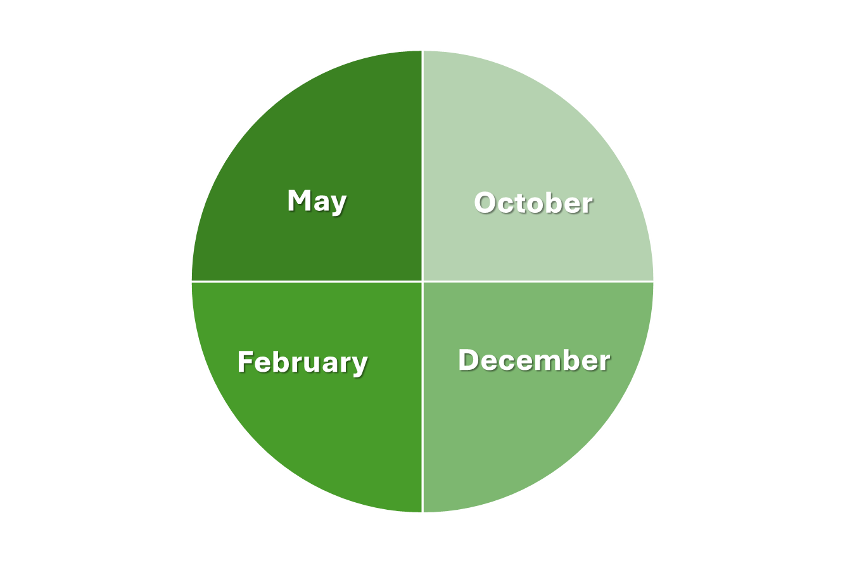
May
Academic & Competitive Excellence
•Final SBC Standings
•Academic Review
•Approved BOG Budget
October
Athletics Department Overview
•Review & Renew
•Organization Chart
•Campus Collaborations
•Executive Summary Evaluation Tool
ACTIVITY WHEEL
February
Department Procedures & Institutional Compliance
•Annual Report on Title IX Compliance
•Report from Faculty Athletics Representative
•Review of new and updated department procedures
December
Extraordinary Student-Athlete Experience
•Holistic Student-Athlete Review
•Student-Athlete Recognition and Achievement
•Community Service Updates
Recurring Materials/Items
NCAA Legislative Updates
Athletic Teams Updates
Head Coach & Admin Intros

Slide 3
AGENDA
Athletics Department Overview
Review & Renew
Athletics Department Organizational Chart
Campus Collaborations/Centers of Excellence
Executive Summary Evaluation Tool
The Game Plan
Head Coach & Admin Introductions

Slide 4
REVIEW AND RENEW

Slide 5
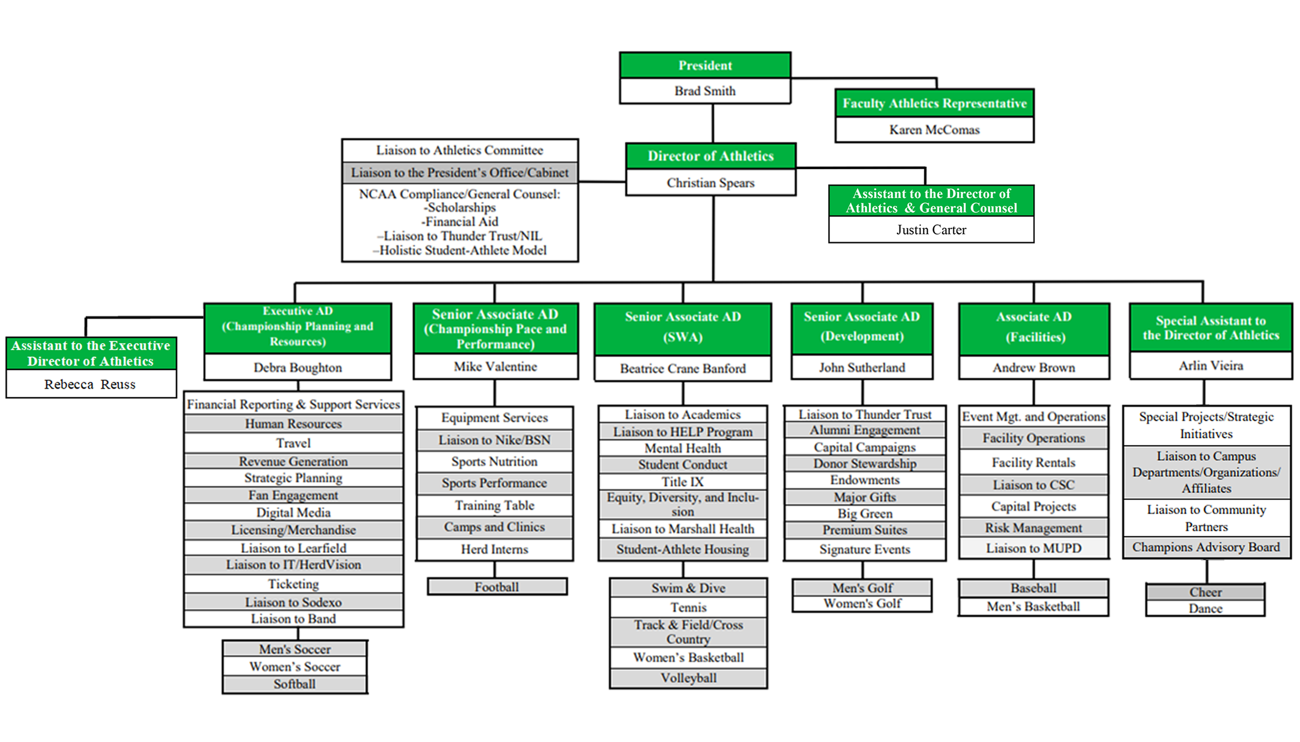
ORGANIZATIONAL CHART

Slide 6
CENTERS FOR EXCELLENCE
CURRENT
NEXT UP

Slide 7
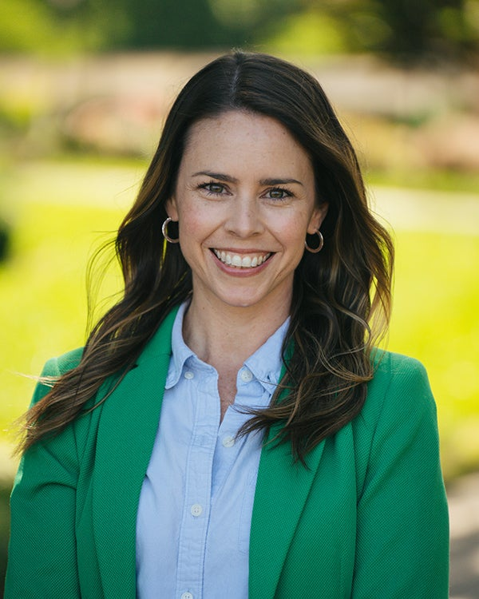
CAMPUS COLLABORATIONS
HERD
HELP
BeHERD

Slide 8
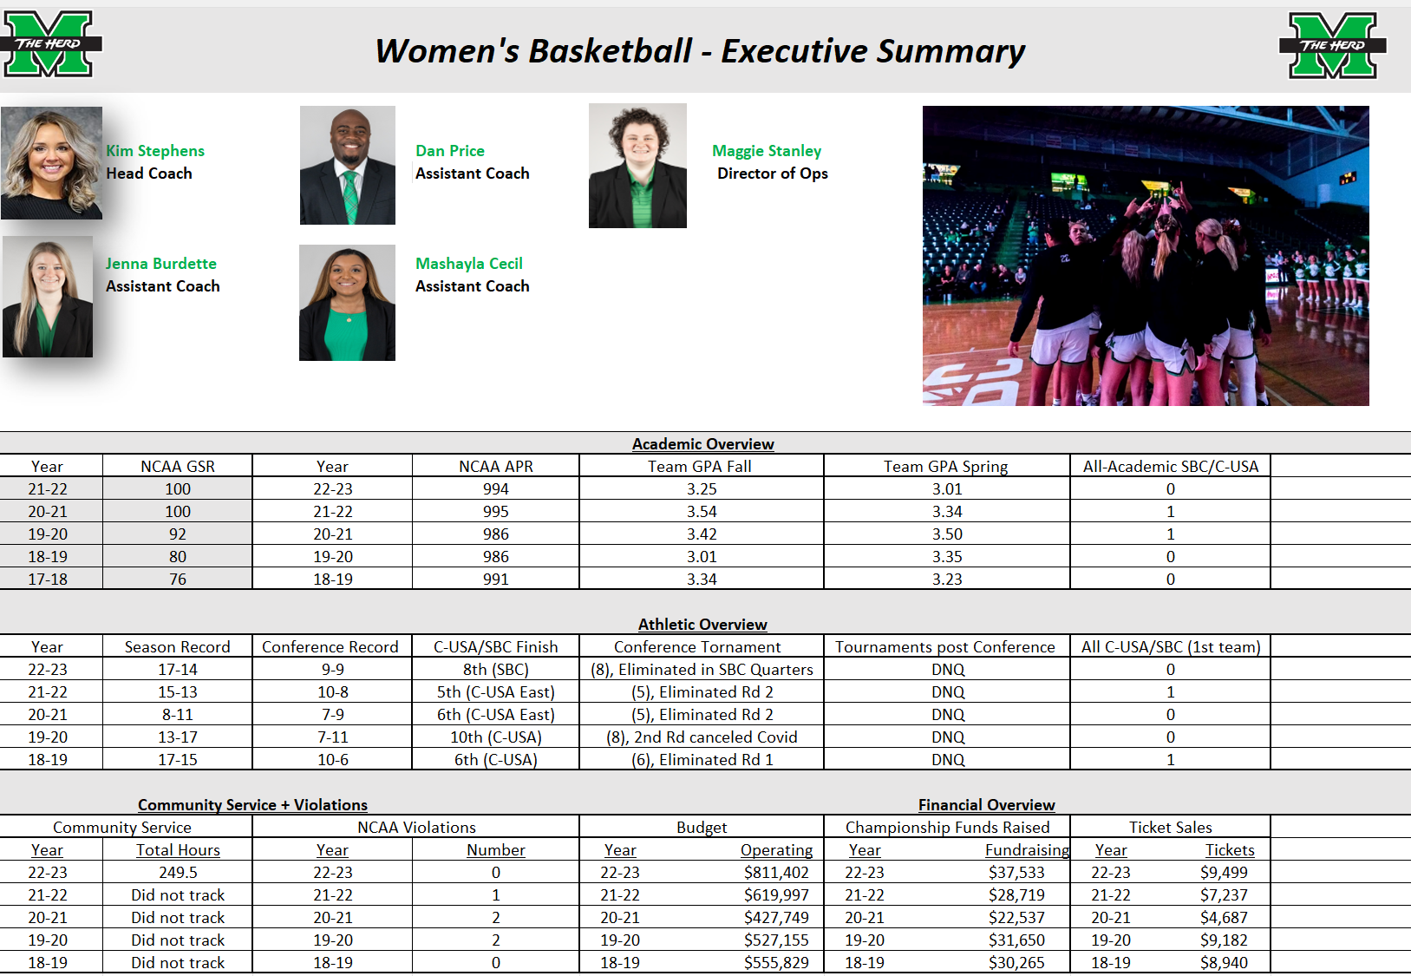
EXECUTIVE SUMMARIES/EVALUATION TOOL

Slide 9
GAME PLAN
Championship Pace
Championship Process
Championship Planning
Championship Performance
Championship Pride

Slide 10
GAME PLAN
Championship Pace
#18 Work with Campus Facilities & Operations to relocate trash receptacle from outside Cam Henderson Center

Slide 11
GAME PLAN
Championship Process
#7 Partner with campus admissions to implement admissions dashboard for incoming student-athletes

Slide 12
GAME PLAN
Championship Planning
#4 Create Herd Intern program to provide work experience opportunities for student-athletes no longer able to compete with their teams

Slide 13
GAME PLAN
Championship Performance
#1 Complete Academic All-American display in Buck Harless Academic Center

Slide 14
GAME PLAN
Championship Pride
#12 Complete process to send students virtual game tickets to all home football games

Slide 15
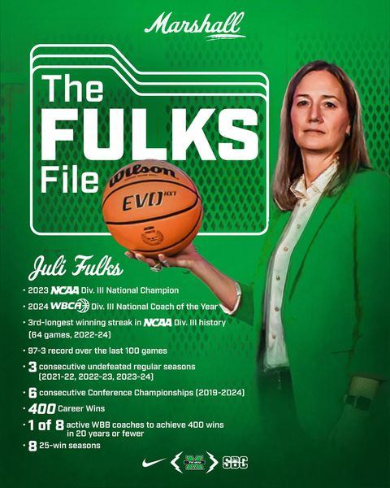
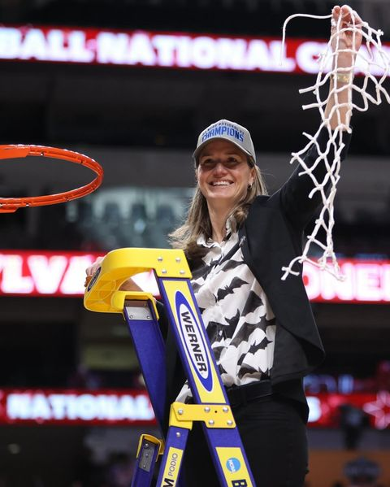
Juli Fulks
Women's Basketball Head Coach​

Slide 16
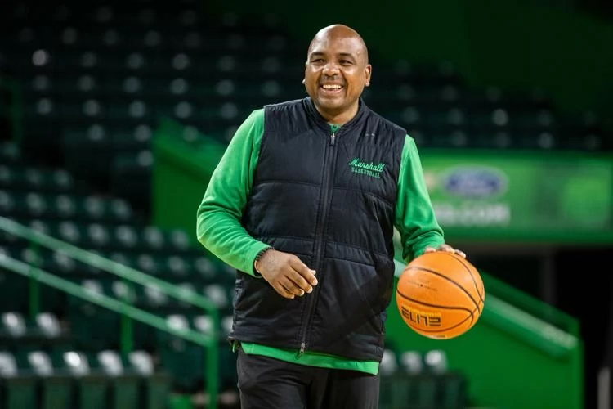
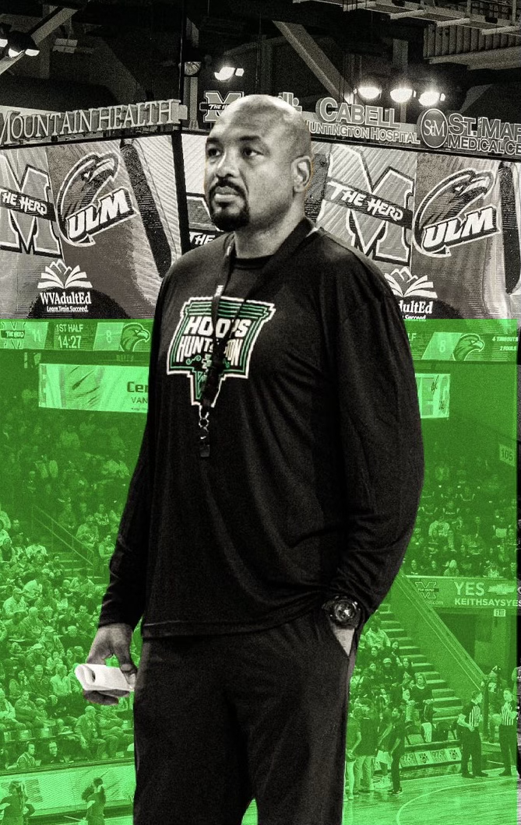
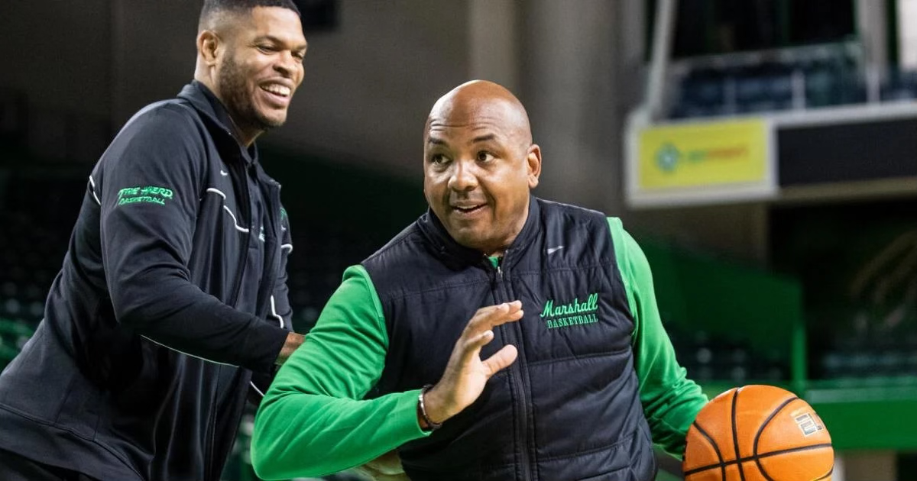
Cornelius Jackson
Men's Basketball Head Coach

Slide 17
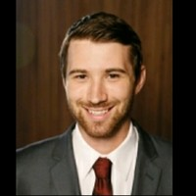
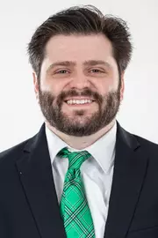
COMPLIANCE UPDATE

Slide 18
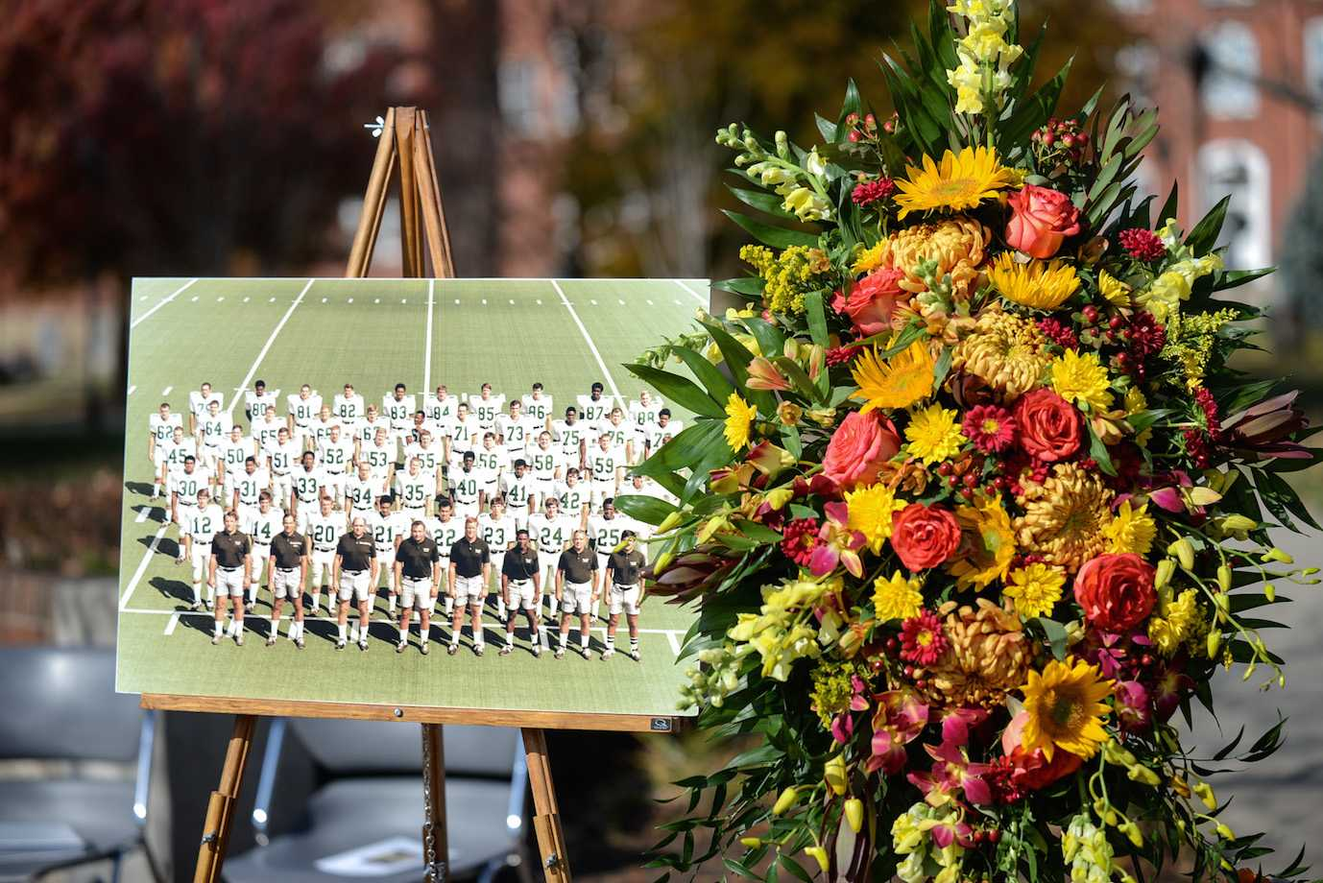
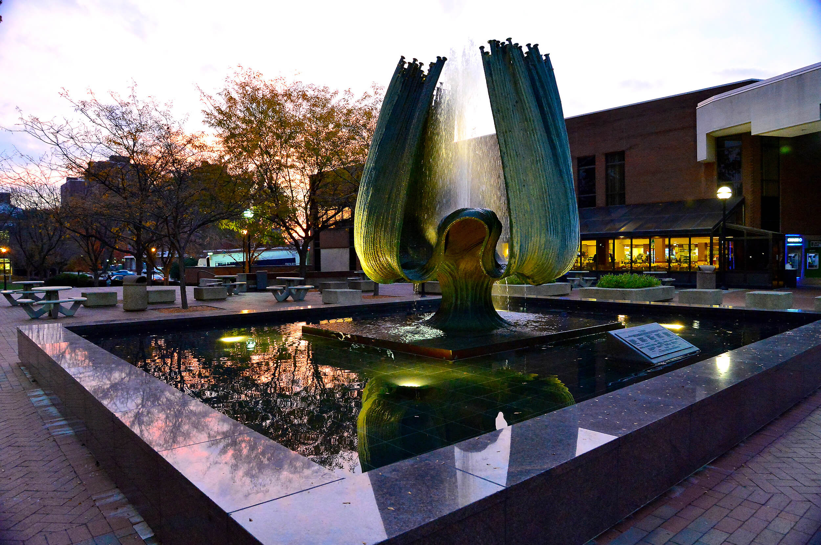
UPCOMING EVENTS:
FOUNTAIN CEREMONY
November 14 @ 12:00 PM
TRIBUTE GAME
November 16 @ TBD

Slide 19
Faculty Senate Athletics Committee
Christian Spears
Director of Athletics
Beatrice Crane
Senior Associate AD

